Slide 1

Welcome to Powerpoint Persentation on *Pollution*

Slide 2

Types of Pollution :-
1- Air Pollution
2-Noise Pollution
3-Soil Pollution
4-Water Pollution

Slide 3

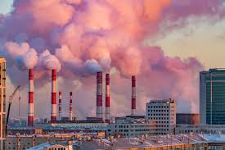
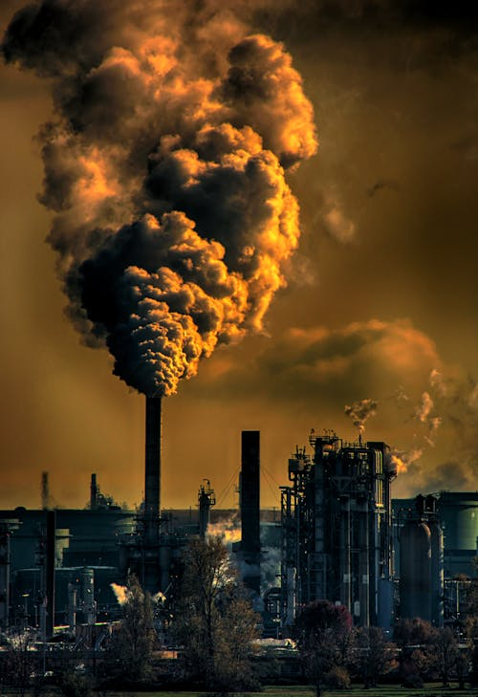
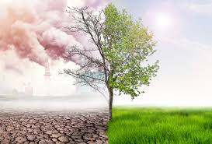
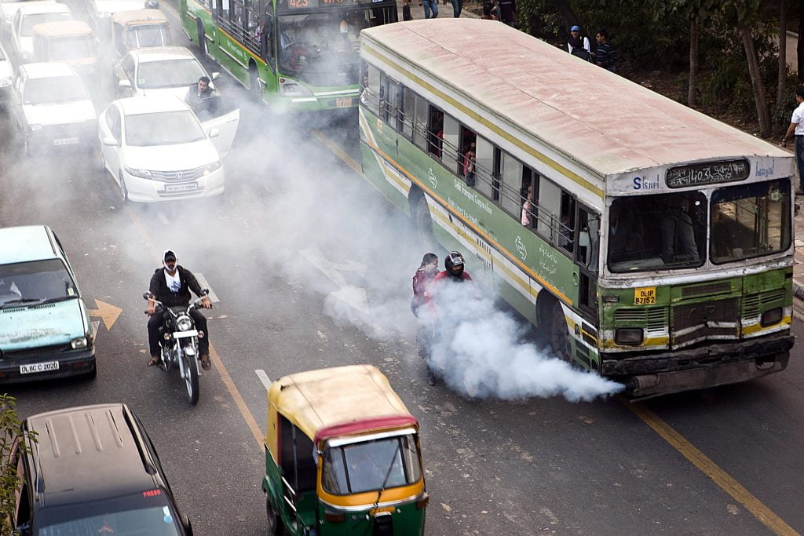
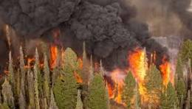
*Air Pollution*
Air pollution is caused by solid and liquid particles and certain gases that are suspended in the air. These particles and gases can come from car and truck exhaust, factories, dust, pollen, mold spores, volcanoes and wildfires. The solid and liquid particles suspended in our air are called aerosols.

Slide 4

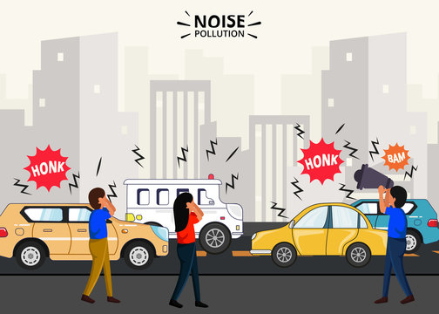
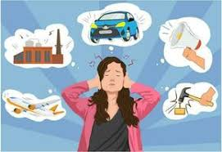
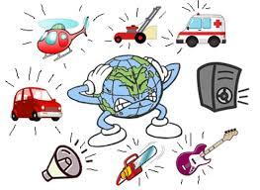
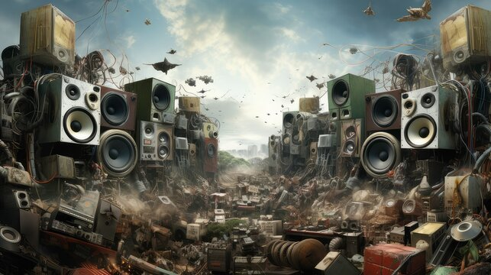
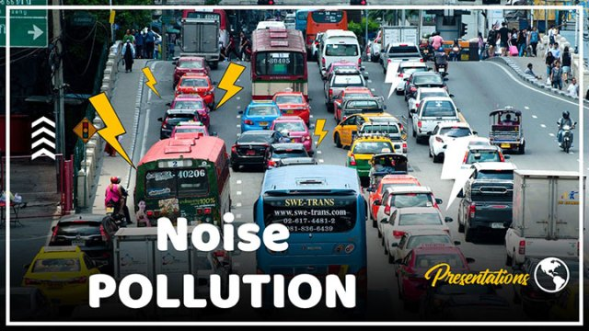
Noise Pollution
Noise is unwanted sound. Noise can be produced by many sources - man's vocal cord, a running engine, a vibrating loudspeaker diaphragm, an operating machine tool, and so on.

Slide 5

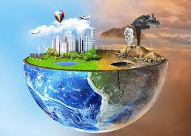
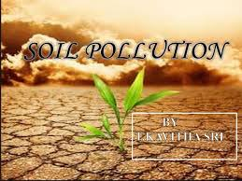
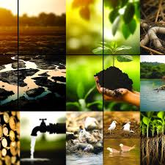
*Soil Pollution*
What causes Soil Pollution? Human activities are the primary cause of soil pollution and land degradation. By the end of this topic, you will know how different forms of human activities are responsible for the majority of different types of soil pollution.

Slide 6
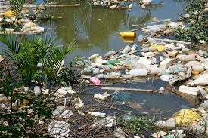
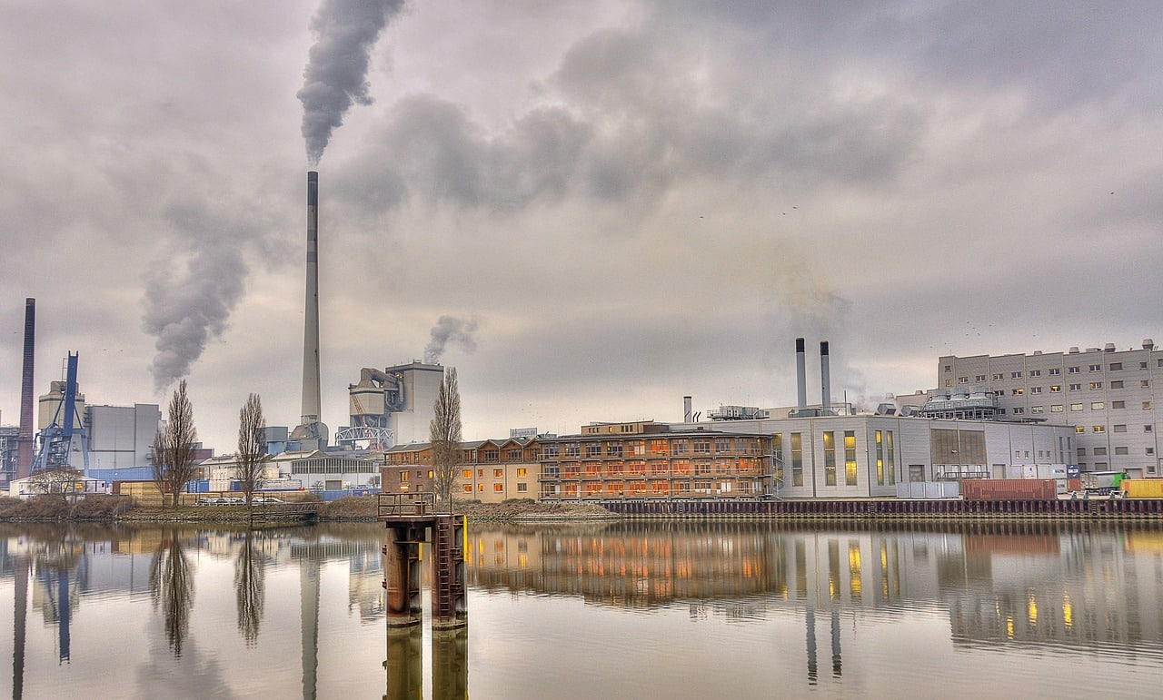
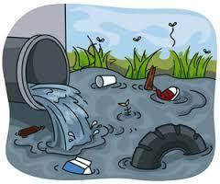
Water Pollution
Water bodies include lakes, rivers, oceans, aquifers, reservoirs and groundwater. Water pollution results when contaminants mix with these water bodies.

Slide 7

Thank You

